Slide 1
Library Substitute
Login Guide

Slide 2
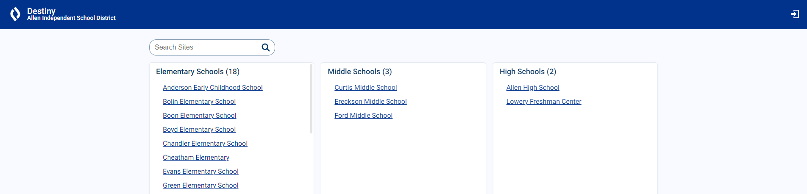
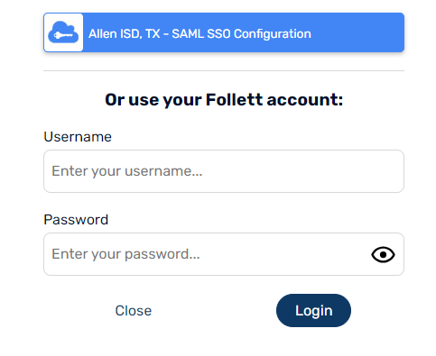
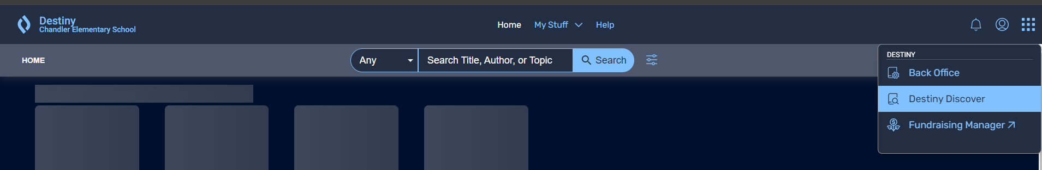
Library Log In Guide
Library Sub Login
Substitute Desktop Login
Library Sub will use the daily substitute to log into the computer assigned to the librarian ONLY
(Cont to PG2 for instructions to log into Check In/Out or Search Computers)
This password changes daily
If you try this login 3 times and cannot log in, please contact Campus Tech for assistance.
After logging into Librarian’s computer with the Substitute Desktop Login, use the information below to access Destiny Substitute Account
Destiny Sub Login
Open https://allenisd.follettdestiny.com/
Access to Check In, Check Out and Library Search
No AISD Portal Access
Username : xxxlibsub
Password : sub.xxx24
If this does not work contact Crystal, she can reset.
From select Back Office

Slide 3
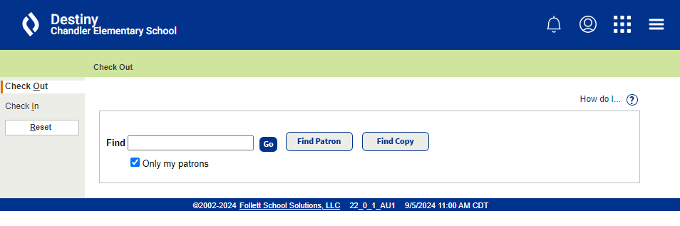
Library Log In Guide
Student Check In/Out and Search Computers
Generic Library Desktop Login - xxx.library
Access to Desktop computers only 6 AM to 6 PM M-F
Student Check In/Out and Search computers
No AISD Portal Access
Please contact Campus Tech or call IT Help Desk (x400200) if you have problems logging into the Check In/Out or Search Computers with these credentials.
After logging into Library computers with the Generic Library Desktop Login, you will use the information below to access Destiny Student Check In/Out.
Destiny Login - Student Check in/out
Use https://allenisd.follettdestiny.com/
Destiny login only for use on Student Check in/out computers
Access to toggle between Library Check In/Check Out only
No Portal Access
Username : xxxcheck
Password : lib.xxx24
If this does not work contact Crystal, she can reset.

