Slide 1
Library Login Guide

Slide 2
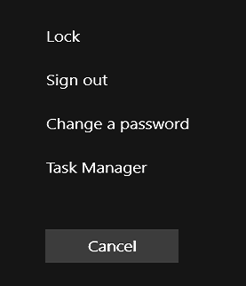
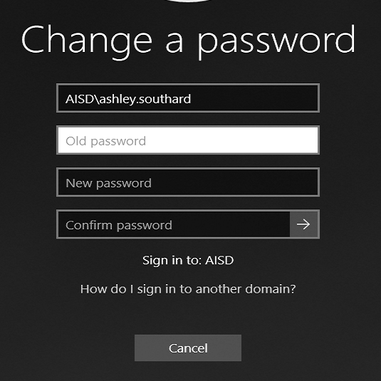
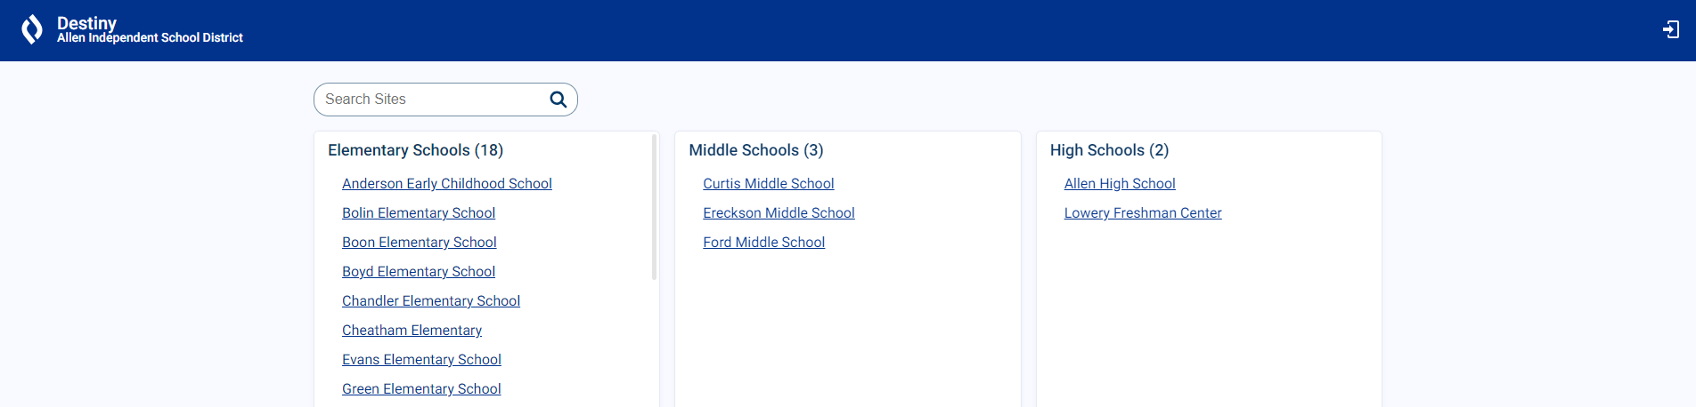
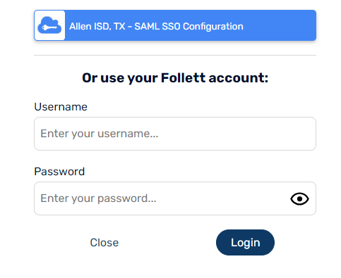
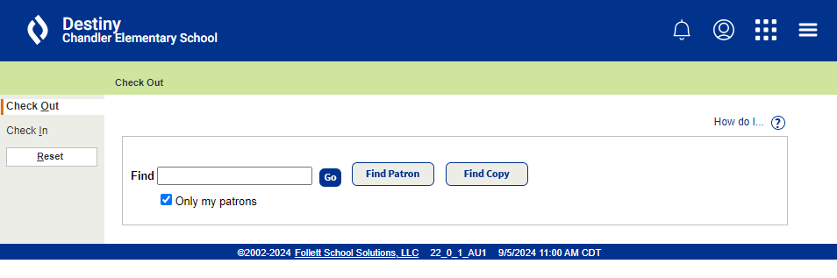
Library Log In Guide
Student Check In/Out and Search Computers
Generic Library Desktop Login - xxx.library
Access to Desktop computers only 6 AM to 6 PM M-F
Student Check In/Out and Search computers
No AISD Portal Access
Password must be changed by Librarian every 30 days
Change Password - Generic Library Desktop Login
Must log into desktop computer to change password
Ctrl + Alt + Delete
Select Change a Password
Enter old password and
new password in next fields
If you cannot log into your library computers with the Generic Library Desktop Login, call Help Desk for assistance x400222.
After logging into Library computers with the Generic Library Desktop Login, you will use the information below to access Destiny Student Check In/Out.
Destiny Login - Student Check in/out
Use https://allenisd.follettdestiny.com/
Destiny login only for use on Student Check in/out computers
Access to toggle between Library Check In/Check Out only
No Portal Access
Username : xxxcheck
Password : lib.xxx24
If this does not work contact Crystal, she can reset.

Slide 3
Library Log In Guide
Library Sub Login
Substitute Desktop Login
Library Sub will use the daily substitute to log into the computer assigned to the librarian
This password changes daily
If you try this logn 3 times and cannot log in, please contact Campus Tech for assistance.
After logging into Librarian’s computer with the Substitute Desktop Login, use the information below to access Destiny Substitute Account
Destiny Sub Login
Open https://allenisd.follettdestiny.com/
Destiny Sub login only for use when logged into a computer with Substitute Desktop Login
Access to Check In, Check Out and Library Search
No AISD Portal Access
Username : xxxlibsub
Password : sub.xxx24
If this does not work contact Crystal, she can reset.

