Slide 1
Login to Laserfiche

Slide 2
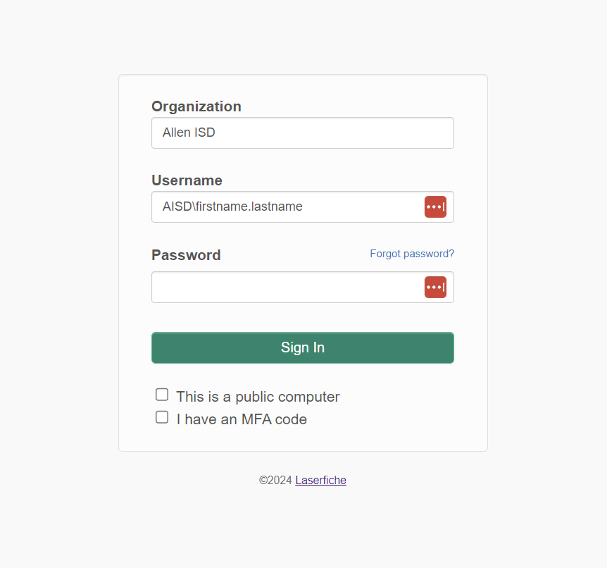
Login to Laserfiche
Login to Laserfiche with username AISD\firstname.lastname and your network password

