Slide 1
Lab Coat Quality Standard

Slide 2
Definitions
        Stain & Damage Defect:
        A stain and damage defect is a quality issue related to stains, holes, tears, or other unremedied issues. A defect might be acceptable to some customers, and not acceptable to others. All defects will be identified using a red tie or tag.
        Finish Defect:
        A finish defect is a quality issue related to wrinkling, unacceptable press creases, missing buttons or snaps. These defects should not leave the plant in this condition.
        Escape:
        A finish defect that was delivered in an unacceptable status, or a stain and damage defect not identified by the plant using the red twist tie.

Slide 3
Lab Coat Quality Responsibility
        Plant Responsibilities:
        Inspect all coats as they are hung or pressed
        Stain wash all stained coats one time
        Produce a good quality finish (steam or press)
        Fix or replace missing or broken buttons/snaps
        Identify “stain and damage” defects with a red tie or tag
        Service Responsibilities:
        Review defective coats identified by the plant
        Understand customer specific quality expectations
        Replace coats as required to satisfy customers
        Communicate escapes to the plant as needed
Notes:
Why? The Plant needs support from service on how they’re doing with delivering lab coats that are not functional
And you need support with customers who have standards beyond the normal. You both need support.
This understanding and relationship became the foundation of how we would approach quality.

Slide 4
Finish Defects
        A missing button or missing snap
        Excessive wrinkling throughout the coat
        Lapels that do not lay against the chest
        Press creases in the lapel, collar, chest, back, or pockets
        Stain & Damage Defects
        Any sized tear or hole anywhere on the coat
        Any light or dark stain anywhere on the coat
        Discolored or stained knit cuffs
        Note: Ink stains in pockets clearly made by the customer are considered normal and not a defect.

Slide 5
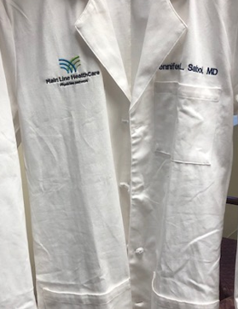
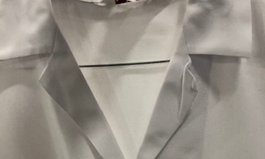
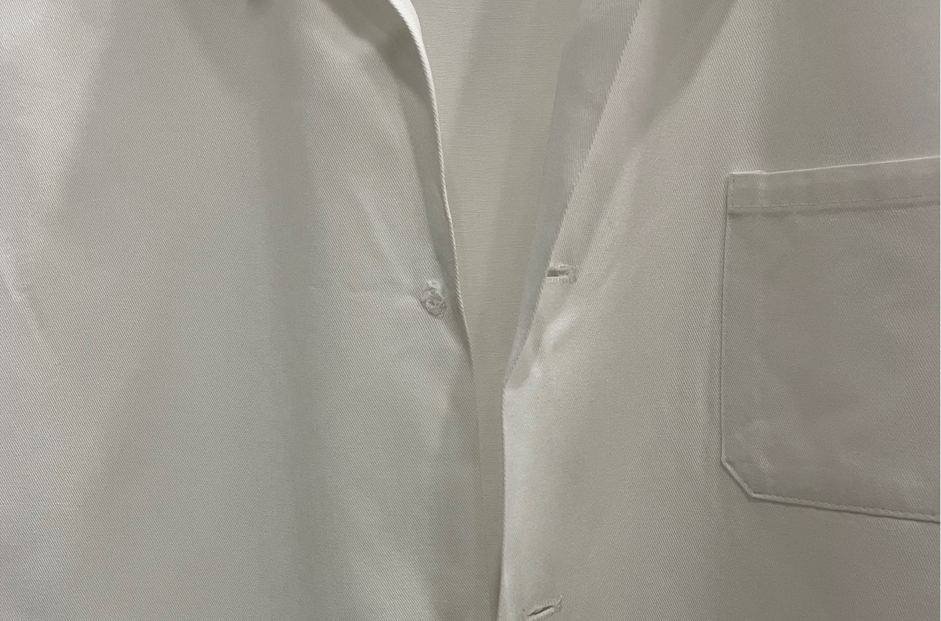
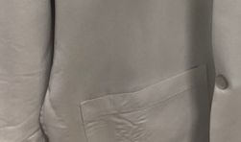

Examples of Finish Defects – Not Acceptable
        Press creases in the lapel, chest, back, or pockets
        Excessive wrinkling
        throughout the coat
        Missing buttons

Slide 6
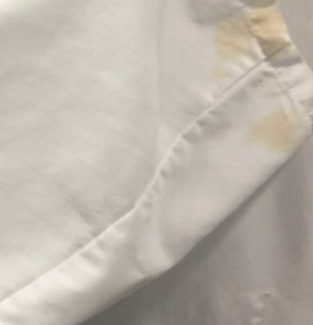
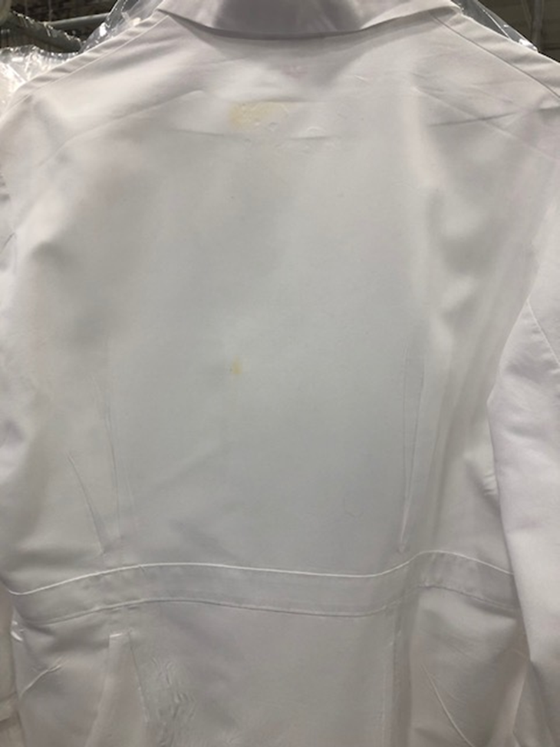
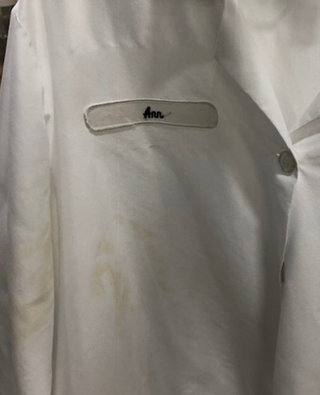
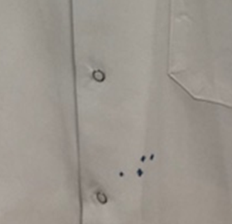
Examples of Stain Defects – Red Flag on Hanger

Slide 7
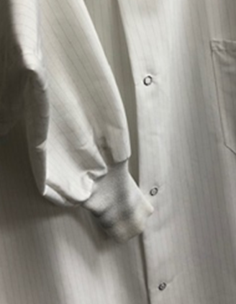
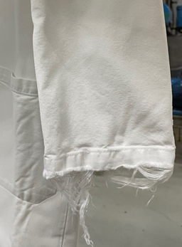

Stain and Damage Defects – Red Flag on Hanger
        Discolored or stained knit cuffs
        Damage
        Light stain on back

Slide 8
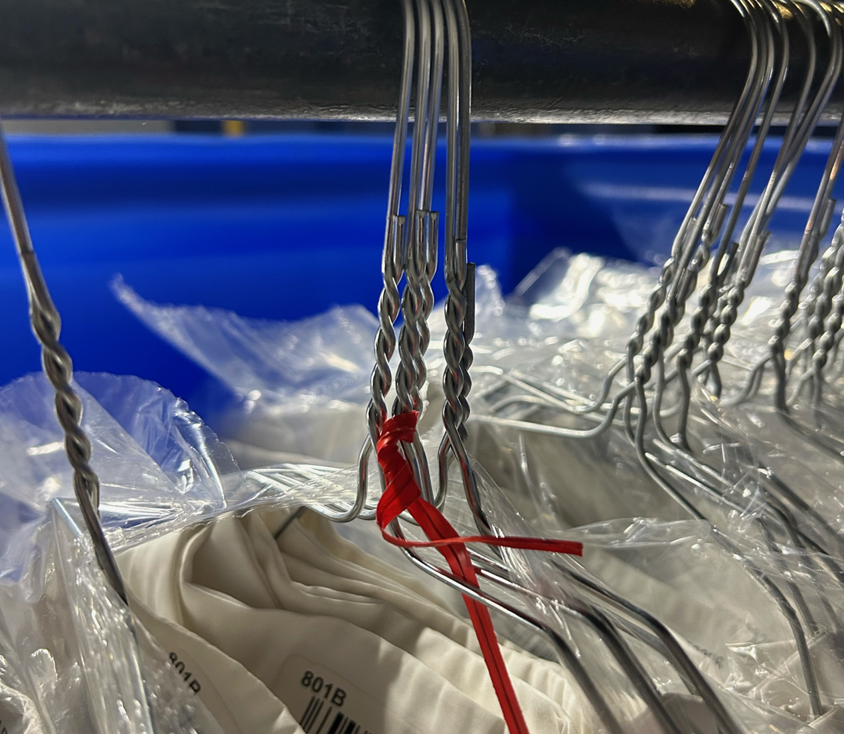
Notifying the RSR of a Defect
The Plant will identify
all Stain and Damage Defects with a Red
Tie or Tag

Slide 9
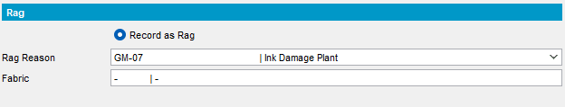
Exception for Ink Load Damage
        The one exception where we expect the Plant to perform replacements is when an ink pen explodes, causing damage that is unacceptable and irreversible. In these cases, the plant should consider replacement and inform the appropriate service team of this of the replacement(s), using this exception is a local decision:
        This is the Replacement Code that should be used:

