Slide 1

CareShield®
Cubicle Curtain Solutions
Operations Overview
What was shared with Sales • What Operations must deliver
Managed. Tracked. Documented.

Slide 2
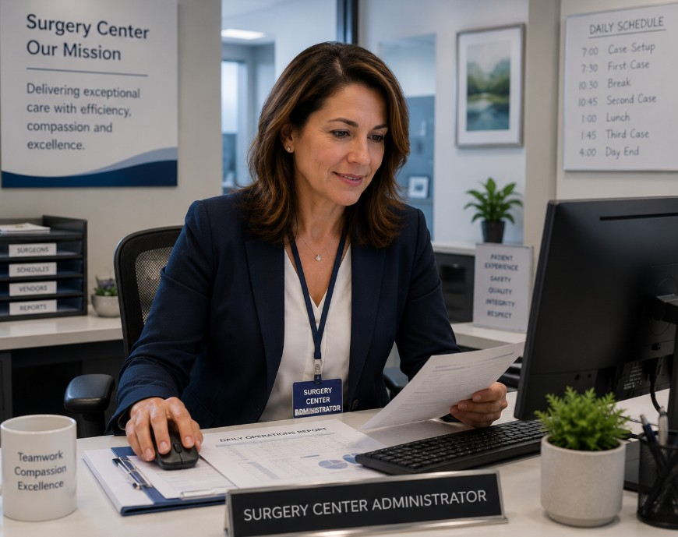
CareShield® | Operations Overview
CareShield solves an unmanaged customer responsibility
Customers often lack a consistent process to:
Schedule curtain exchanges
Document when curtains were serviced
Coordinate removal, laundering and reinstallation
Respond confidently to compliance questions
Managed. Tracked. Documented.
2

Slide 3
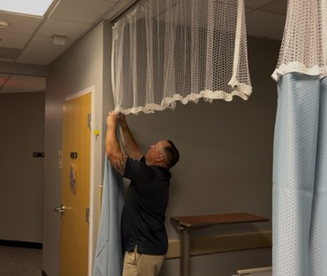
CareShield® | Operations Overview
A two-piece snap system makes service practical
STANDARD PANEL
66″ × 66″
One approved blue option
MADE-TO-FIT MESH
Sized for each bay
Mesh dimensions vary based on ceiling height and track width.
Mesh and panel connect securely with snaps.
Managed. Tracked. Documented.
3

Slide 4
CareShield® | Operations Overview
The approved program is Managed Rental
Managed Rental
Sales guardrail
Nixon Medical owns the curtain panels and mesh
The CareShield pricing tool contains pre-approved pricing within the vetted program scope.
Standard quarterly or semiannual service cadence
Weekly billing based on on-site inventory
Anything outside that scope requires preapproval.
Removal, installation, laundering and tracking are coordinated
Managed. Tracked. Documented.
4

Slide 5
CareShield® | Operations Overview
COG is structured - but remains non-standard
Customer-Owned Goods (COG)
Why the guardrail matters
Structured pricing is available
Customer-owned processing increases complexity and the risk of damage, loss and a poor customer experience.
Every COG opportunity follows the existing non-standard approval process
COG-only curtain accounts are not permitted without an approved exception
Managed Rental remains the scalable priority
Managed. Tracked. Documented.
5

Slide 6
CareShield® | Operations Overview
Ownership must be clear from sale through weekly service
Sales
Data Processing / IT
Service
Production
Qualify, measure and quote within scope
Set up products, account, cadence and reporting
Deliver, exchange, scan and communicate
Receive, process, scan, quality-check and stage
GM role: confirm local readiness, reinforce ownership and remove execution gaps.
Managed. Tracked. Documented.
6

Slide 7
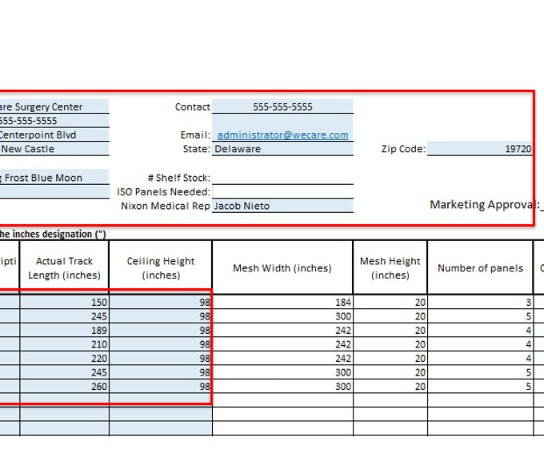
CareShield® | Operations Overview
Setup accuracy drives every downstream step
Facility and contact information
Department, room and area description
Track length and ceiling height
Curtain and mesh quantities
Quarterly or semiannual cadence
Correct ABS product and consumption-point setup
Managed. Tracked. Documented.
7

Slide 8
CareShield® | Operations Overview
Cadence is built backward from Week 13 or Week 26
Quarterly program
Semiannual program
Target completion: Week 13
Target completion: Week 26
13 ← 12 ← 11 ← 10 ← … ← 1
26 ← 25 ← 24 ← 23 ← … ← 1
Curtain groups are assigned backward from Week 13 so the full rotation is completed within the quarterly cycle.
Curtain groups are assigned backward from Week 26 so the full rotation is completed within the semiannual cycle.
HOW THE WEEKLY DELIVERY IS SET
The total curtain quantity is divided across the available service weeks. Nixon Medical then exchanges the planned group each week until every assigned location has completed the selected cycle.
Both frequencies are supported and may be sold.
Managed. Tracked. Documented.
8

Slide 9
CareShield® | Operations Overview
Service owns three customer-facing stages
1
ASSESS
2
INSTALL
3
EXCHANGE
Walk every included area, assign a unique Bay ID, document quantities, mesh, track conditions, access and contacts.
Use the Delivery Note and Bay map, verify fit and operation, scan every installed curtain and confirm green OK.
Follow the scheduled Bay IDs, install and scan clean curtains, bag and return soiled curtains, then IN SCAN at the plant.
Every Bay, Every Curtain and Every Unresolved Issue must be documented.
Managed. Tracked. Documented.
9

Slide 10
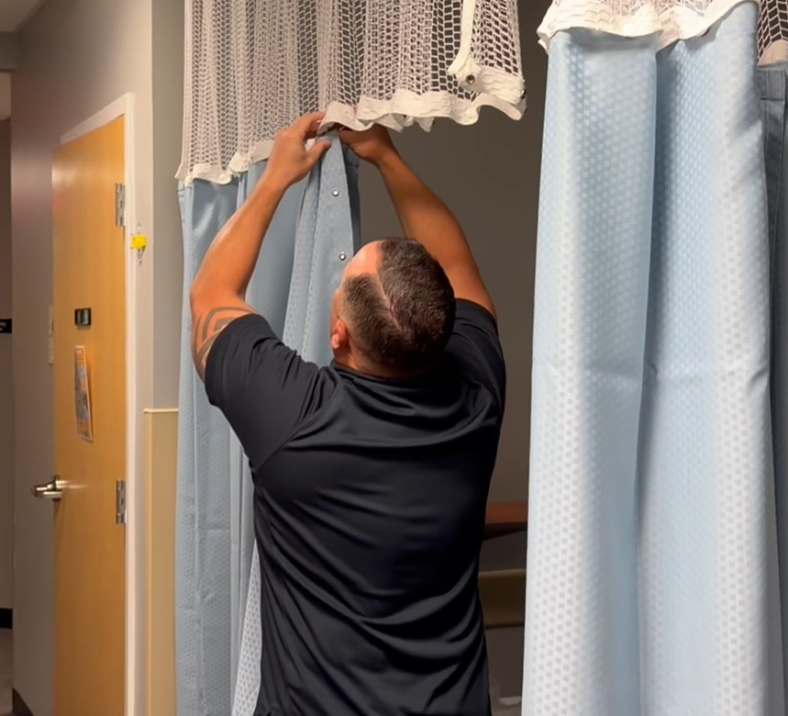
CareShield® | Operations Overview
The scheduled exchange has six required actions
Review the next-day Put-Up and plant loadout
Use the Delivery Note to confirm the exact Bay ID
Remove and immediately bag existing curtains
Install clean curtains and confirm proper operation
Scan each clean curtain; confirm green OK and upload
Return, IN SCAN and place soil in the designated area
Managed. Tracked. Documented.
10

Slide 11
CareShield® | Operations Overview
Mesh stays in place unless there is a service need
Mesh is barcoded and billed weekly as on-site inventory, but it is not automatically replaced on the curtain cadence.
Replace mesh when damaged
Replace mesh when visibly soiled
Replace mesh when requested by the customer
Do not create a recurring mesh exchange demand
Managed. Tracked. Documented.
11

Slide 12
CareShield® | Operations Overview
Production owns three controlled stages
1
ORDER + IDENTIFY
2
PROCESS
3
FULFILL
Confirm the approved form and quantity, create the ABS work order, order product and attach one unique, legible ID tape to every curtain and mesh.
Retrieve from the designated cage, wash in the 275 Washer, dry completely, hand off for immediate inspection and package one curtain per sealed Felins package.
Review daily Put-Ups, create and verify the Delivery Note, Out Scan each curtain, bundle with the visible note and stage in the correct route cubbie.
Managed. Tracked. Documented.
12

Slide 13
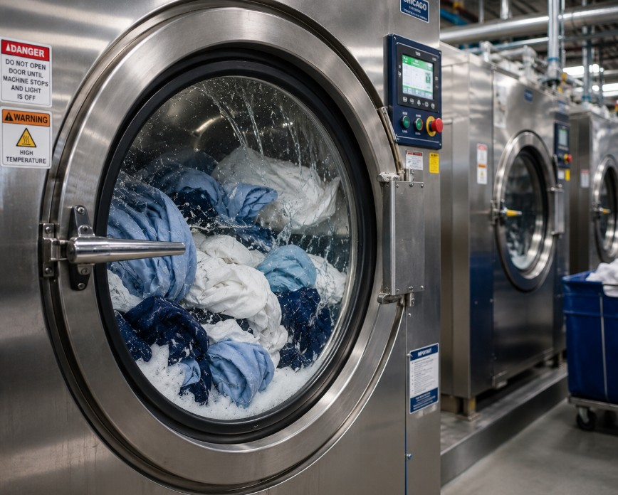
CareShield® | Operations Overview
Plant processing has product-specific non-negotiables
Keep CareShield curtains in the designated return flow
Use the 275 Washer and approved formula - never the CBW
Dry curtains completely in the designated stand-alone dryer
Move clean curtains on a small clean cart
Hand off immediately for folding and inspection
Seal one curtain per Felins package and use designated storage
Managed. Tracked. Documented.
13

Slide 14
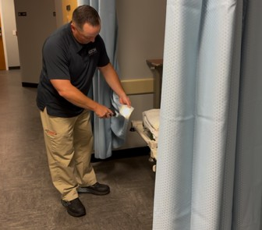
CareShield® | Operations Overview
Every scan supports the customer record
Required checkpoints
Delivered clean at the customer
Picked up soiled from the customer
Received into the plant
Processed and returned to available inventory
Assigned to the next customer delivery
If a scan is missed, the history is incomplete.
Managed. Tracked. Documented.
14

Slide 15
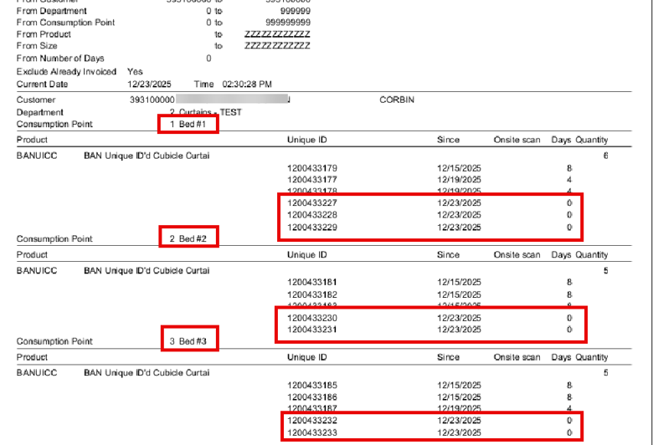
CareShield® | Operations Overview
Reporting is available when the customer requests it
Service receives the customer request
The appropriate ABS report is pulled
The report shows available program history
Information is reviewed before being shared
Questions or data gaps are escalated internally
The current model is reporting upon request—not automated distribution.
Managed. Tracked. Documented.
15

Slide 16
CareShield® | Operations Overview
Tools and training will support consistent execution
READY TO DISTRIBUTE
Service One Best Way
Management training
Production One Best Way
Dedicated sessions will be held for:
CareShield Quote Tool
Service Management Team
Quote Tool Tutorial
How to Properly Measure a Bay video
Production Management Team
Service Team FAQ
The goal is one consistent operating standard across every branch.
Managed. Tracked. Documented.
16

Slide 17
GM readiness checklist
Service and Production leaders have reviewed their 1BW
The standard to protect
ABS, Garment Assist, scanners and device access are ready
A reliable customer experience delivered through disciplined local execution.
Cadence, Bay IDs and weekly quantities are clear
275 Washer, stand-alone dryer, Felins and storage are ready
Scanning, green OK, upload and IN SCAN rules are reinforced
Every exception has an owner and escalation path
Managed. Tracked. Documented.

