Slide 1
How to Make a PDF Searchable

Slide 2
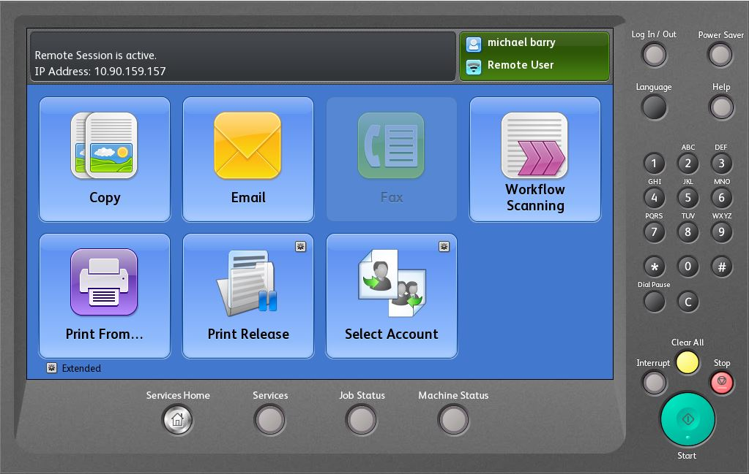
Scan to Email
The first thing you will do in order to make a PDF Searchable is log on to the copier and go to the “Email” Button

Slide 3
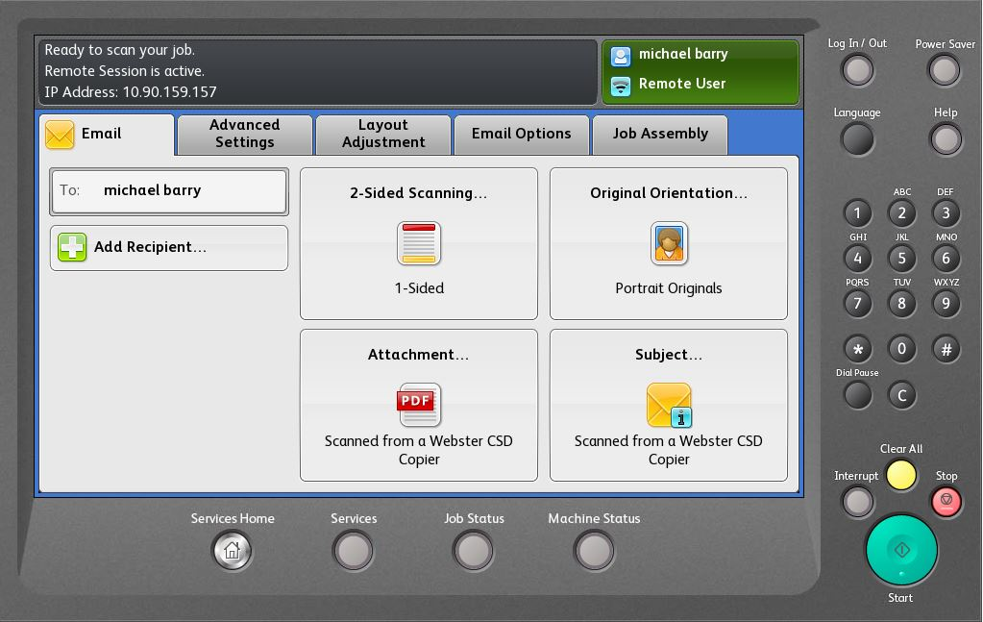
Attachment Options
After you select the “Email” button you will then just select a recipient for your email (which in most cases will just be yourself)
Once you have picked a recipient you will then want to select the “Attachment…” button in the bottom left-hand corner of the screen

Slide 4
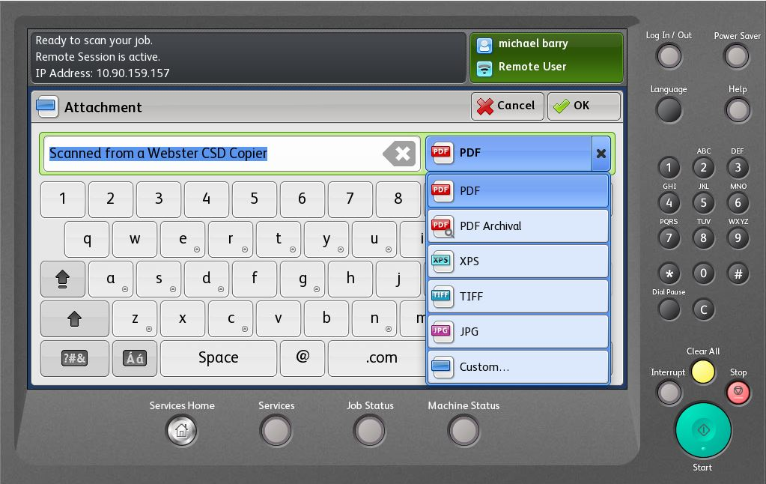
File Types
After you select the “Attachment…” button you will be taken to a screen where you can change the name of the attachment as well as the type of document you want to scan to your email
If you select the “PDF” dropdown (next to where you change the name), you will be shown a bunch of file option but for now you will want to select “Custom…”

Slide 5
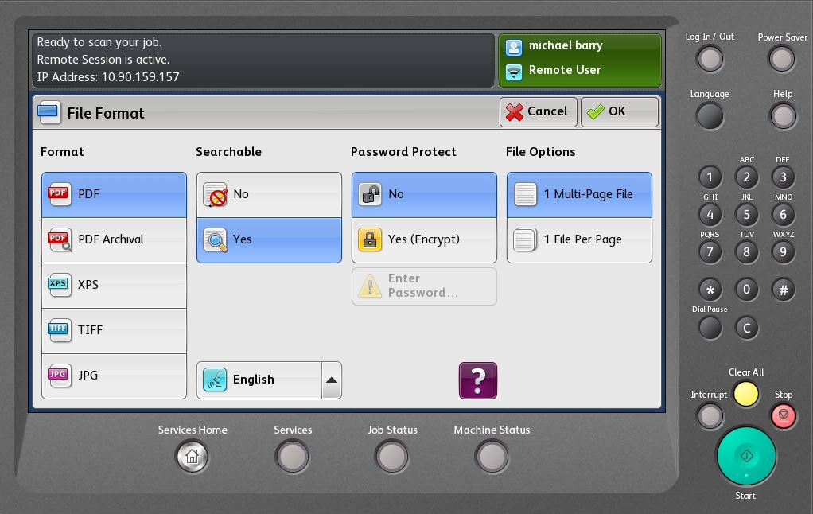
Searchable Option
Once you select “Custom…” you will be taken to a screen with multiple different options for your scan. One of those options is “Searchable”, all you have to do is change that from “No” to “Yes”
After you change that option just select the “OK” button in the top right-hand corner of the screen. Then just finish the scan to email like you normally would do.

Slide 6
Questions
If you have any questions or would like more information please feel free to send an email to wts@webstercsd.org or call the service desk at 265-6400.

